Slide 1
Air Pollution Detector
Community Partner :SOET(Parking area)
Presented by :
Batch No. : 6
2072052-2072061
ECE B

Slide 2
CONTENTS
Introduction
Hardware & Software requirements
Arduino Board
Air Quality sensor
Schematic Diagram
Block Diagram
Working
Advantages
Applications
Future scope
Conclusion

Slide 3
INTRODUCTION
Air pollution is presence of contaminants or pollutant substances that effect human health.
If we know the quantity of pollutant, then proper precautions can be taken to minimize the pollution levels in air.
The main objective of this project is to monitor the air quality in and around the campus of SPMVV.
In this Arduino platform is used to communicate the data simply and quickly.

Slide 4
HARDWARE & SOFTWARE REQURIMENTS
Hardware components:
MQ135 Gas sensor
Arduino Uno
16X2 LCD
Breadboard
10K potentiometer
Buzzer
Software used:
Arduino IDE

Slide 5
ARDUINO BOARD
Arduino is open-source hardware.
An Arduino board consists of an Atmel 8-, 16- or 32-bit AVR microcontroller (ATmega8, ATmega168, ATmega328, ATmega1280, ATmega2560).
Arduino microcontrollers are pre-programmed with a boot loader that simplifies uploading of programs to the on-chip flash memory.
Boards are loaded with program code via a serial connection to computer.
The Arduino board exposes most of the microcontroller's I/O pins for use by other circuits.

Slide 6

ARDUINO BOARD

Slide 7
AIR QUALITY SENSOR
The MQ-135 Gas sensor can detect gases like Ammonia (NH3), sulfur (S), Benzene (C6H6), CO2, and other harmful gases and smoke.
this sensor has a digital and analog output pin.
When the level of these gases go beyond a threshold limit in the air the digital pin goes high. This threshold value can be set by using the on-board potentiometer.
The analog output pin, outputs an analog voltage which can be used to approximate the level of these gases in the atmosphere.

Slide 8
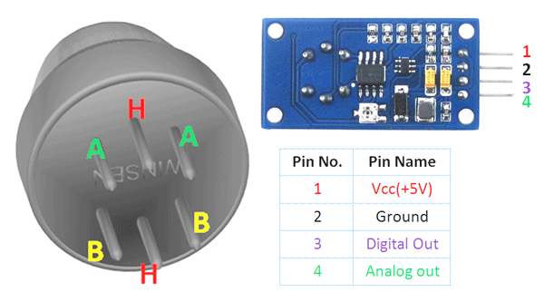
AIR QUALITY SENSOR

Slide 9
SCHEMATIC DIAGRAM

Slide 10
BLOCK DIAGRAM
ARDUINO UNO
MICRO CONTROLLER
16*2 LCD DISPLAY
POWER SUPPLY
WORKING
BUZZER
MQ135 GAS SENSOR

Slide 11
WORKING
The MQ135 sensor can sense NH3, NOx, alcohol, Benzene, smoke, CO2 and some other gases, so it is perfect gas sensor for our Air Pollution Detector Project. When we will connect it to Arduino then it will sense the gases, and we will get the Pollution level in PPM (parts per million). MQ135 gas sensor gives the output in form of voltage levels and we need to convert it into PPM
Sensor was giving us value of 90 when there was no gas near it and the safe level of air quality is 350 PPM and it should not exceed 1000 PPM. When it exceeds the limit of 1000 PPM, then it starts cause Headaches, sleepiness and stagnant, stale, stuffy air and if exceeds beyond 2000 PPM then it can cause increased heart rate and many other diseases.
When the value will be less than 1000 PPM, then the LCD will display “Fresh Air”. Whenever the value will increase 1000 PPM, then the buzzer will start beeping and the LCD will display “Poor Air, Open Windows”. If it will increase 2000 then the buzzer will keep beeping and the LCD will display “Danger! Move to fresh Air”.

Slide 12
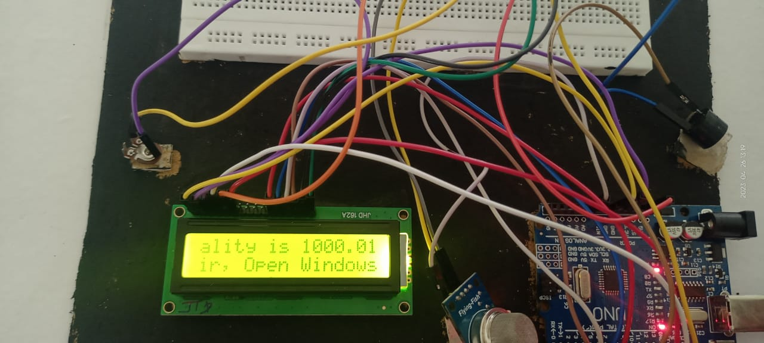
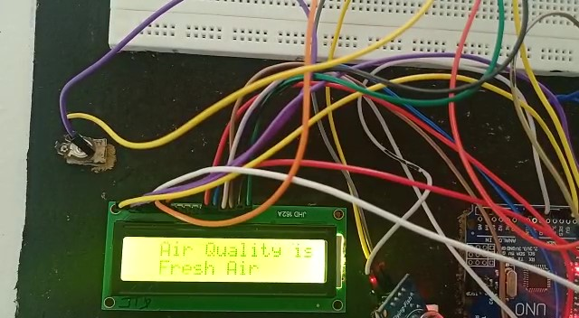
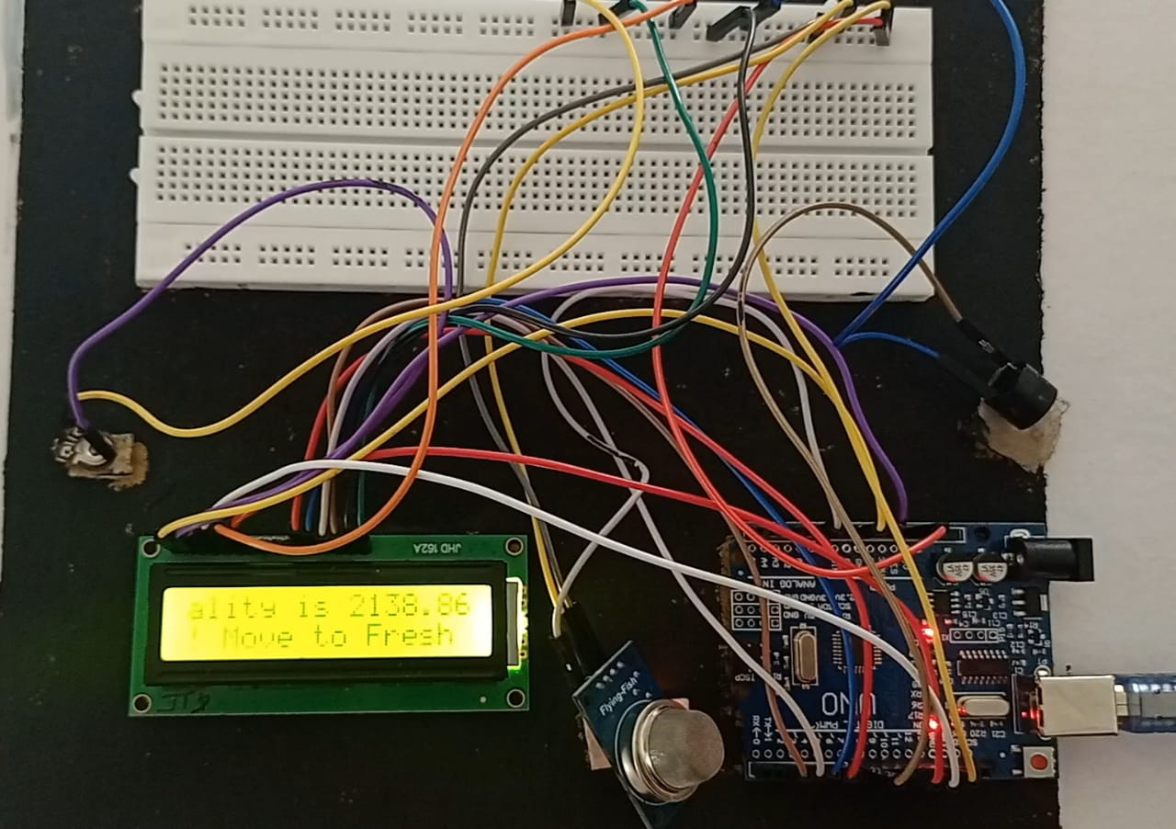
WORKING

Slide 13
ADVANTAGES
Easy to Install
Accurate Pollution monitoring
Making data available to users
Continuous updates of change in percentage of quality
Detects wide range gases like CO2,CO,NH3 etc
Sensors are easily available
Visual output
Indoor quality of air can be checked
It is affordable

Slide 14
APPLICATION
Indoor and outdoor air quality monitoring system
Gas detection systems
Smoke detection

Slide 15
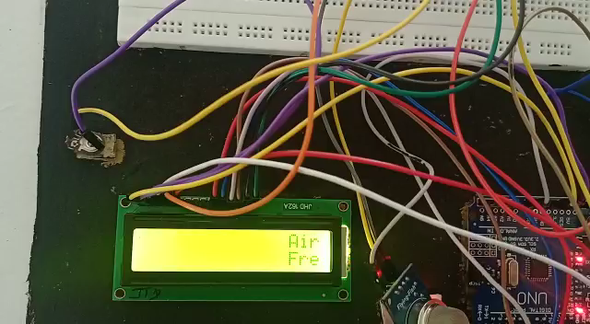

Slide 16
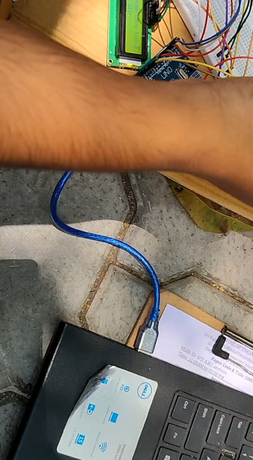

Slide 17
FUTURE SCOPE
In future the project can be upgraded in more ways than one.
Interface more no. of sensors to know gases present in air.
Design webpage and upload data on webpage.
Interface SDCARD to store data.
Interface GPS module to monitor the pollution.
Designing of the system to give the alert message to the mobile phones of users
Automatically turning on the air purification devices based on the information provided by air pollution detector.

Slide 18
CONCLUSION
An air pollution detector using Arduino and MQ-135 gas sensor is a cost-effective and efficient solution to monitor air quality. The MQ-135 gas sensor detects various harmful gases present in the air such as carbon monoxide, nitrogen dioxide, and sulfur dioxide. The data collected by the gas sensor is processed by the Arduino microcontroller, which analyzes the air quality and provides real-time information on the air quality. With this device, users can monitor the air quality in their surroundings and take necessary measures to protect their health. It can also be used in various industrial settings to ensure that the air quality meets the required standards. Overall, an air pollution detector using Arduino and MQ-135 gas sensor is a useful and accessible tool to improve the air quality and create a healthier environment for everyone.

Slide 19


